Slide 1

Cellulo
The Social robot that stimulates the brain and the body

Slide 2
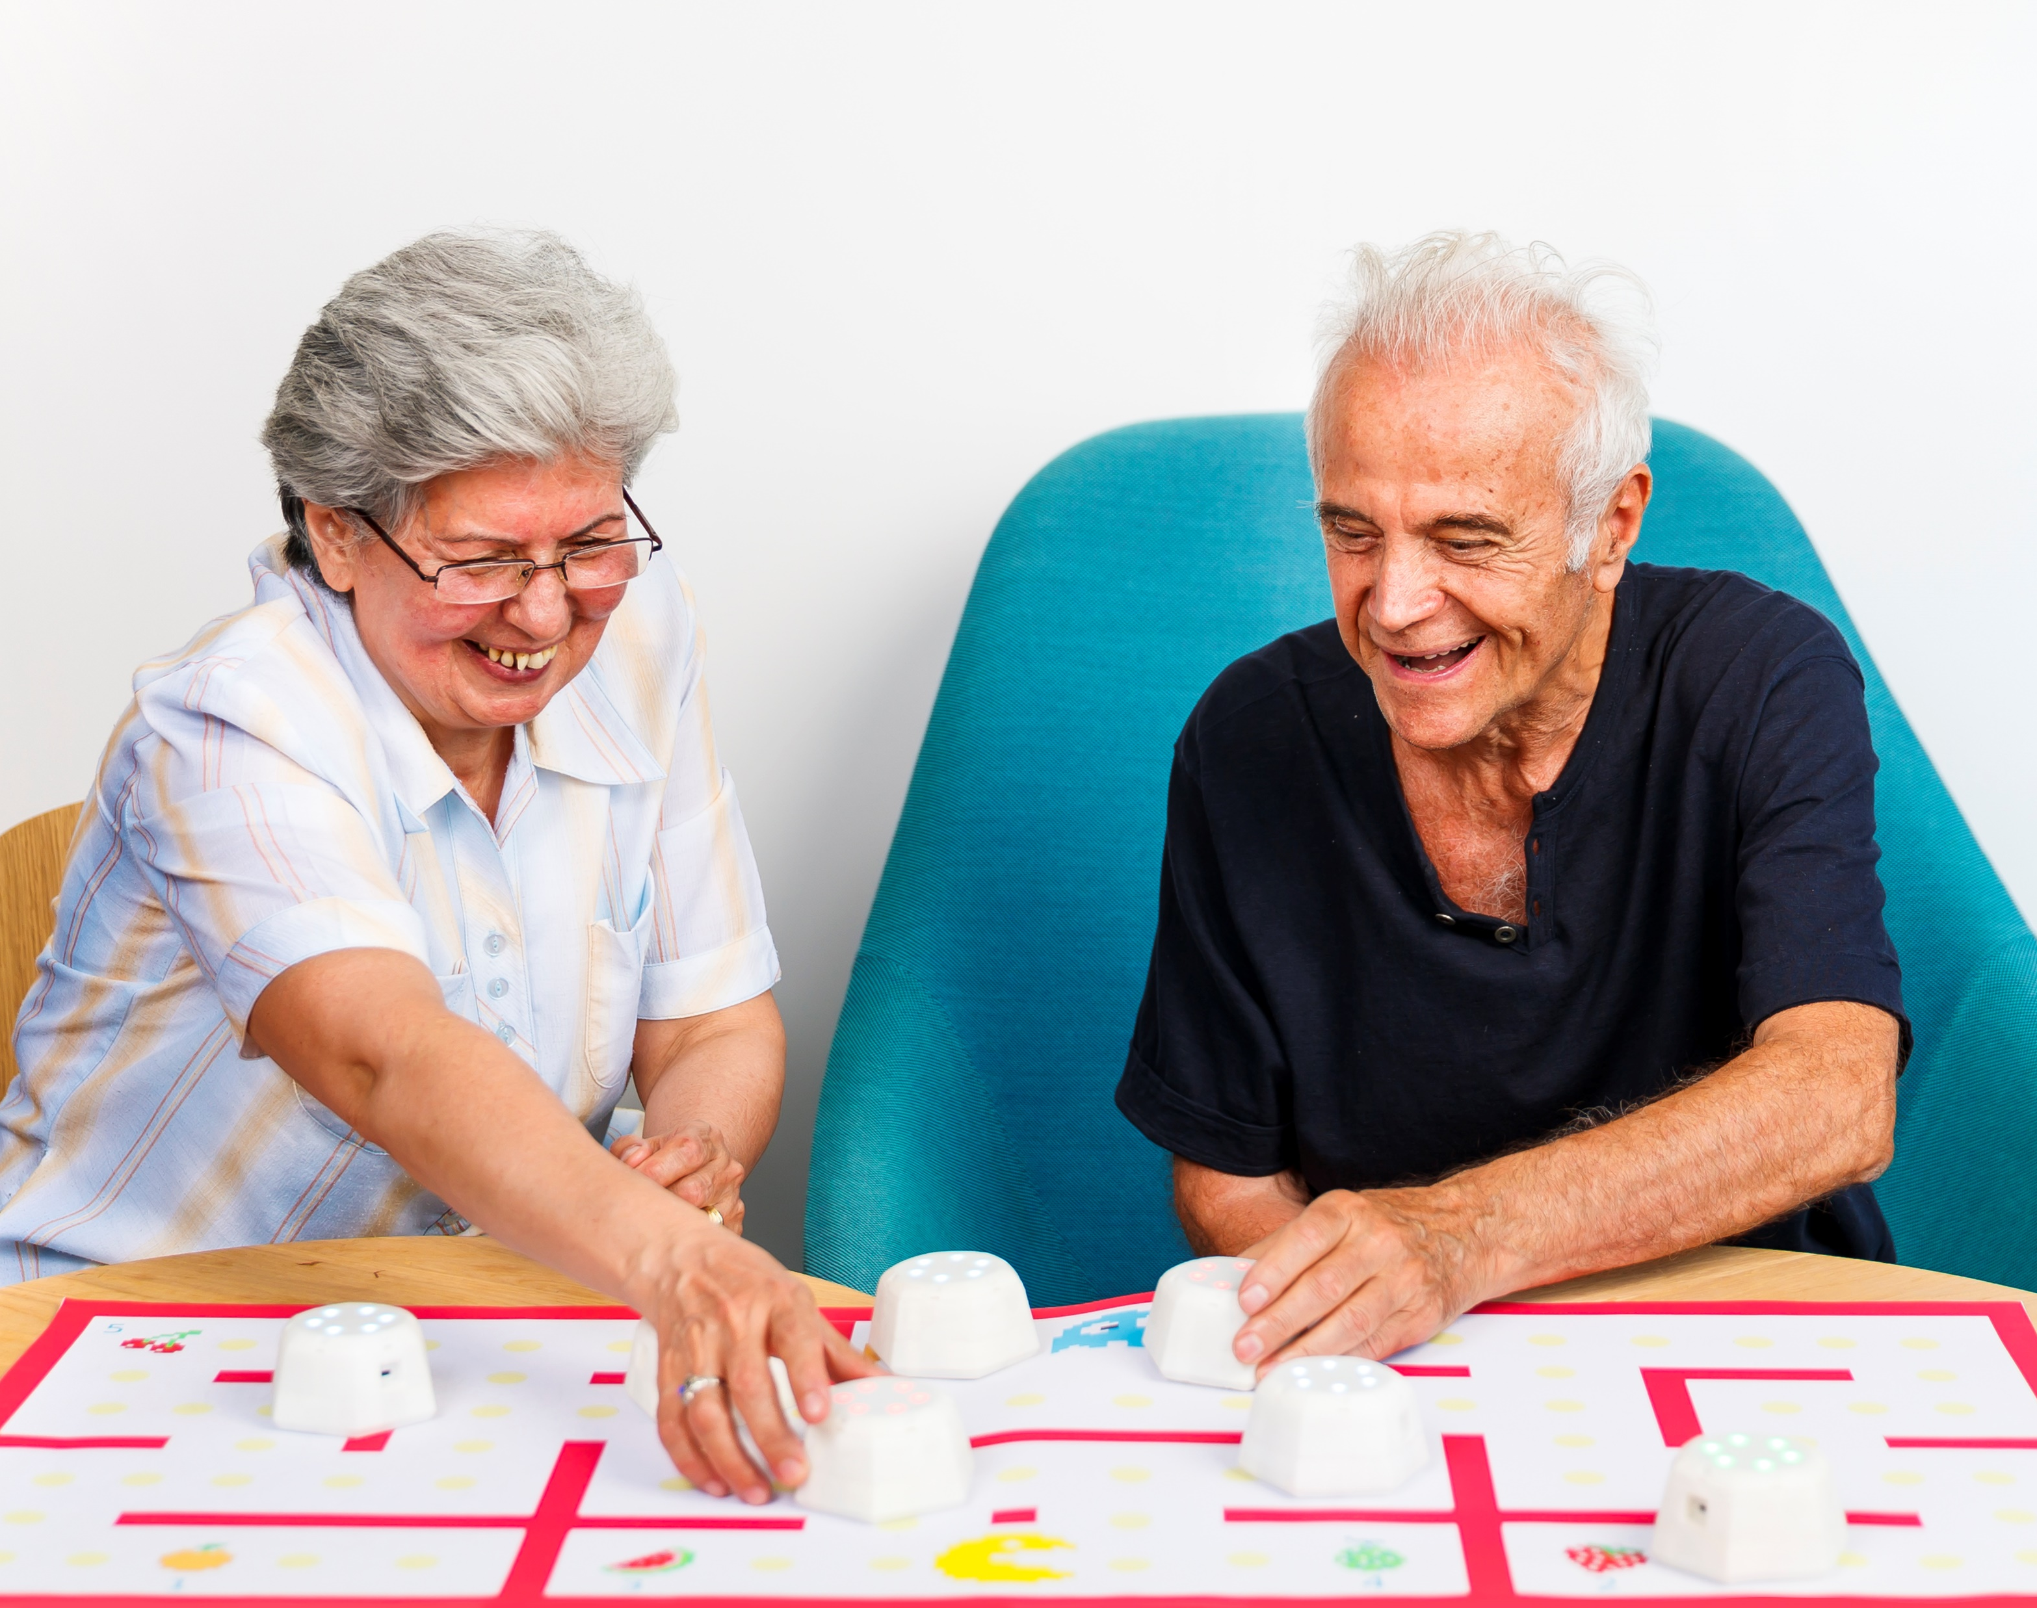
Cellulo -Healthy Aging robot
Healthy aging
Cellulo is a robot tailored to engage older adults in activities and games that help exercising hand-eye coordination and make the brain stay sharp.
Family leisure
Cellulo activities and games enable the interaction between family members, regardless of age, providing fun to all the family.
Remote interaction
Cellulo provides the opportunity to connect with other Cellulo all around the world, making you feel like you’re all playing in the same room!

Slide 3



Cellulo features
Modular User Interfaces
VR Synergy
Performance Tracking
Interchangeable user interfaces to adapt to different activities and necessities
Scalable to use with Virtual and Augmented Reality, allowing innovative scenarios and activities.
Accurate tracking of the usage, providing multiple information to tailor the usage and progress of users.

Slide 4




Cellulo features
Optimal Localization
Haptic Feedback
Autonomous motion
Perfect tracking of position with sub-millimeter precision.
Haptic assistance enables active guidance, trajectory correction, remote feedback, vibration…
Capable of seamless active and passive motion.

Slide 5



Cellulo features
Easy to deploy
Remote interaction
Community Driven
Intuitive to use and easy to deploy.
Allows interaction between users in different location in real time.
Open-source SDK that enable users to develop and share their own activities.

Slide 6
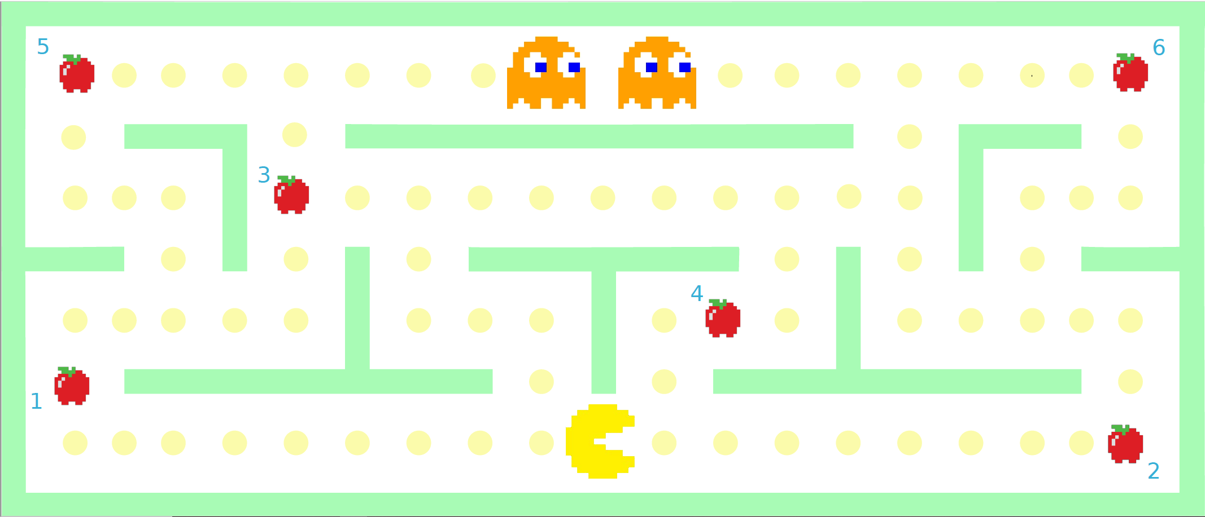
How to use cellulo
01
04
Print the map for the activity
Place the robots on the map
02
05
Connect the robots to the tablet
Start the activity in the tablet
03
06
Select the number of players
Have fun while exercising mind and body

Slide 7
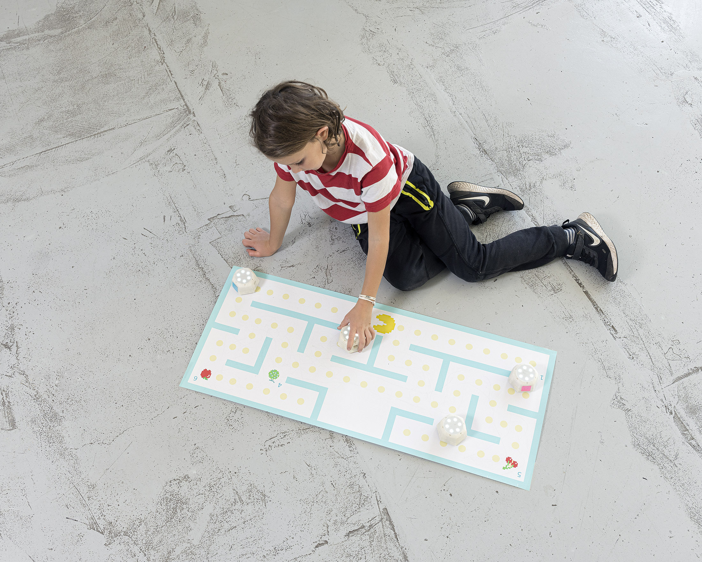
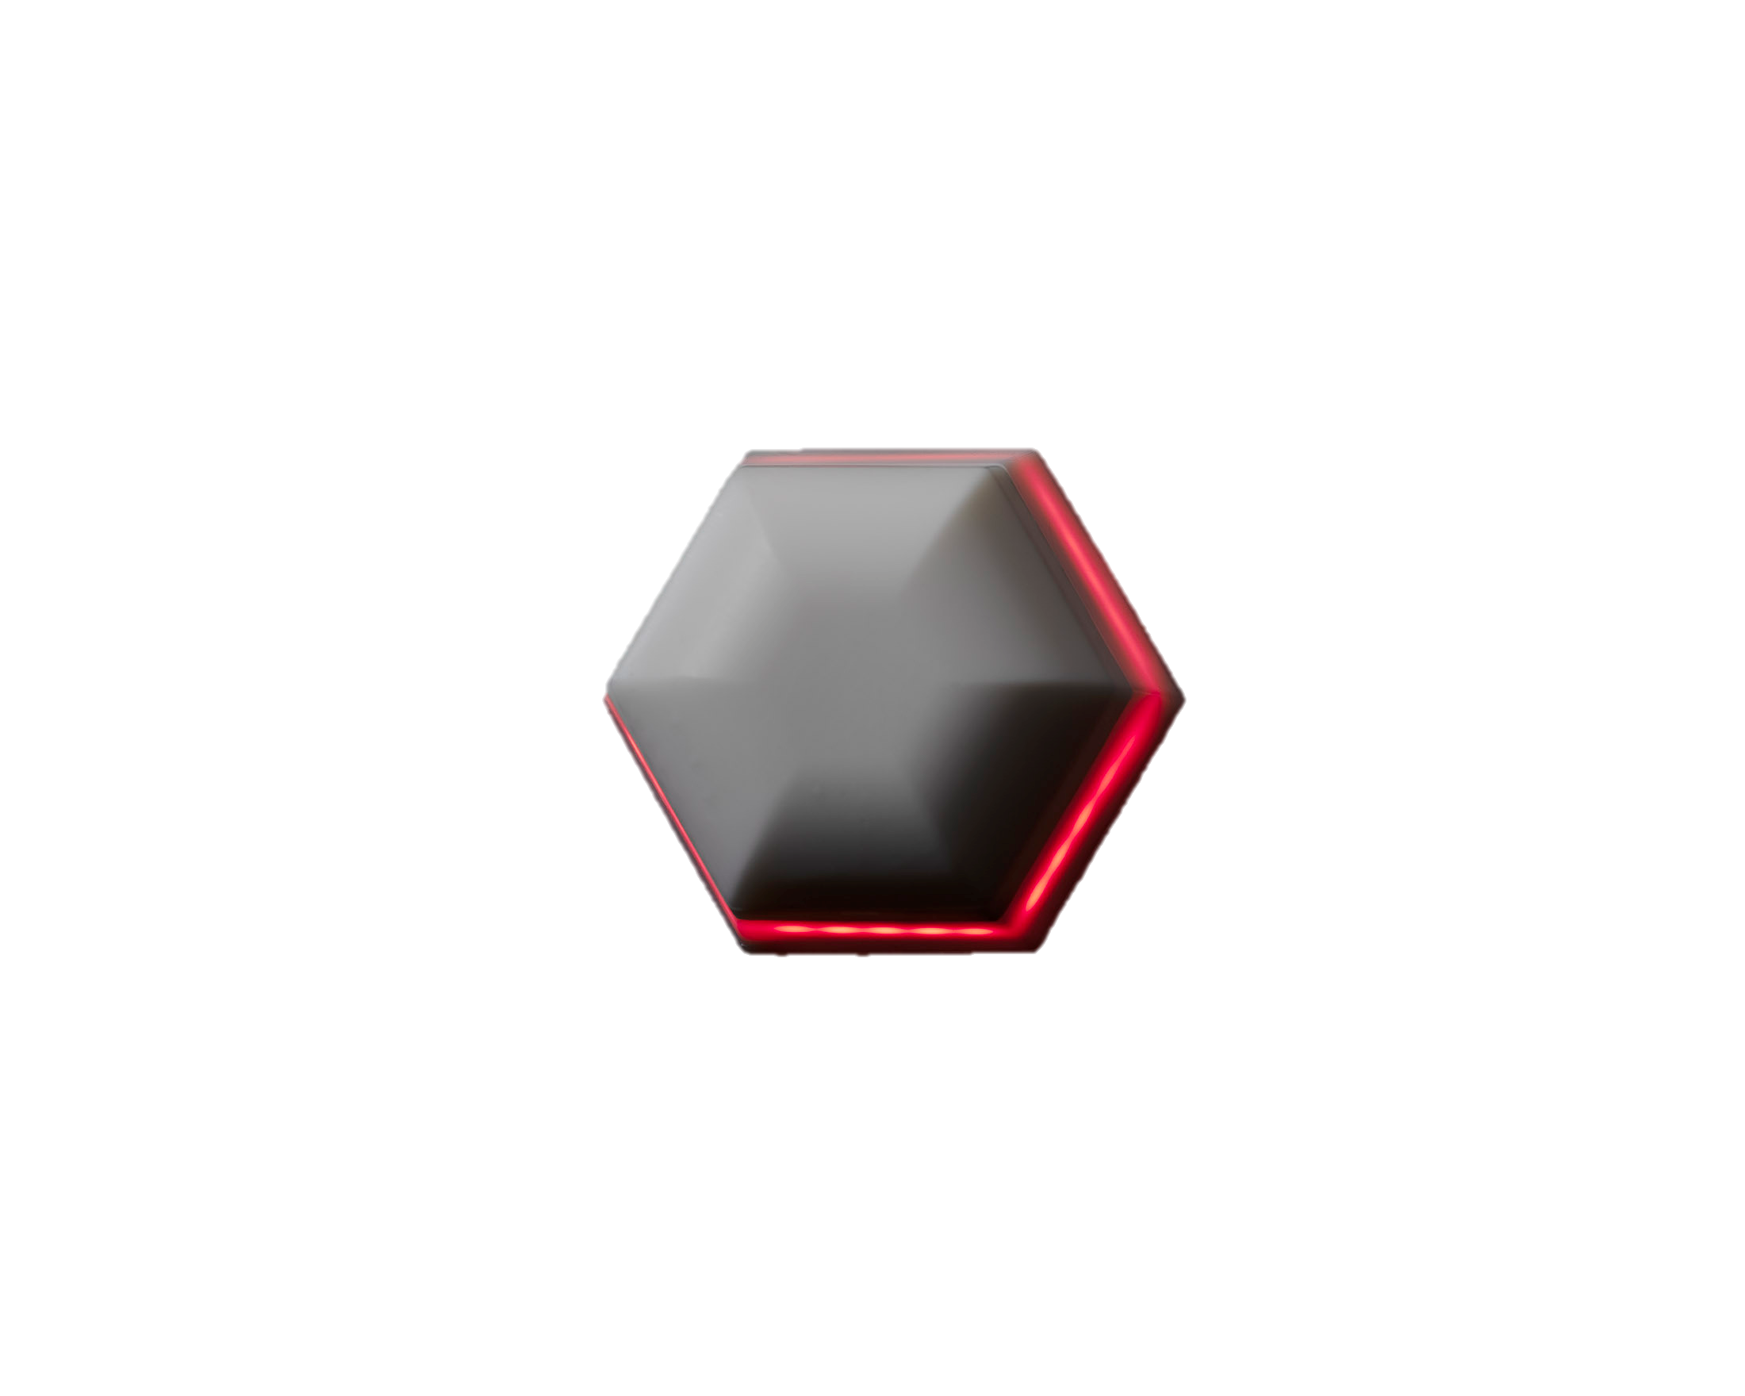
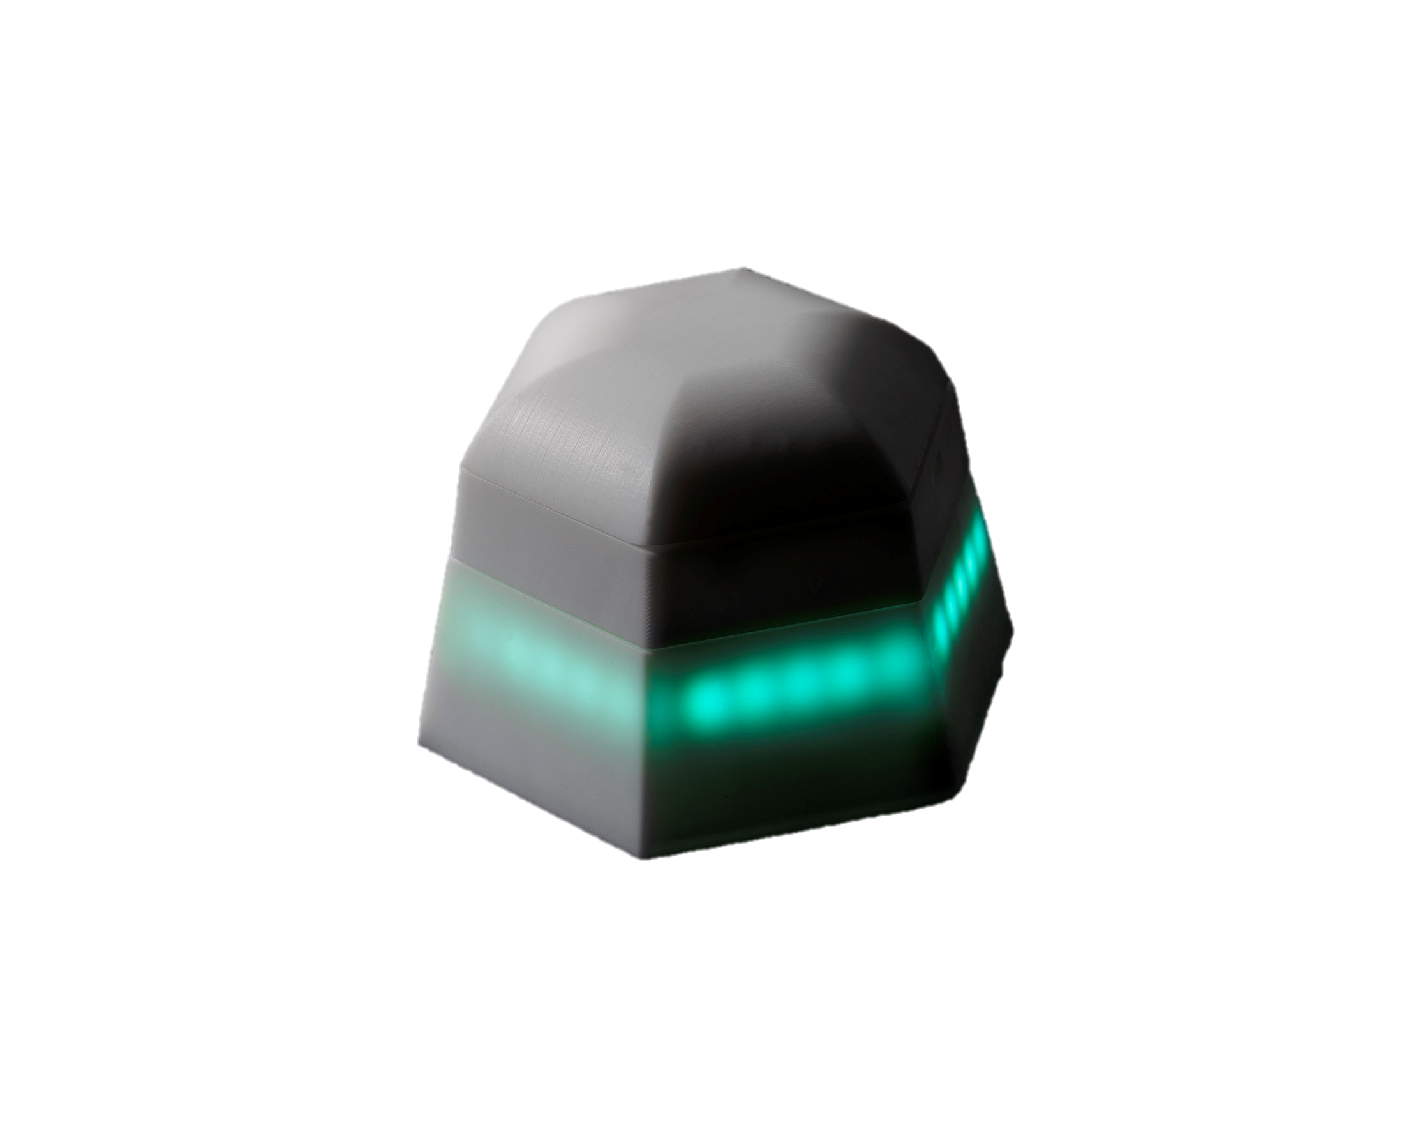
Technical characteristics

Slide 8
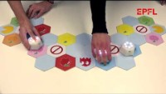
Cellulo – Use case

